Slide 1
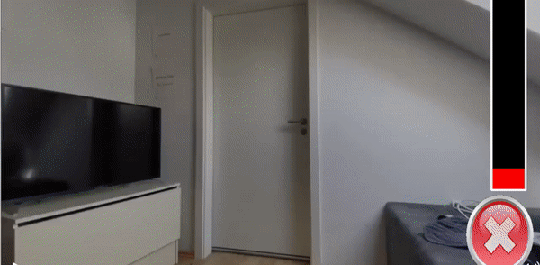
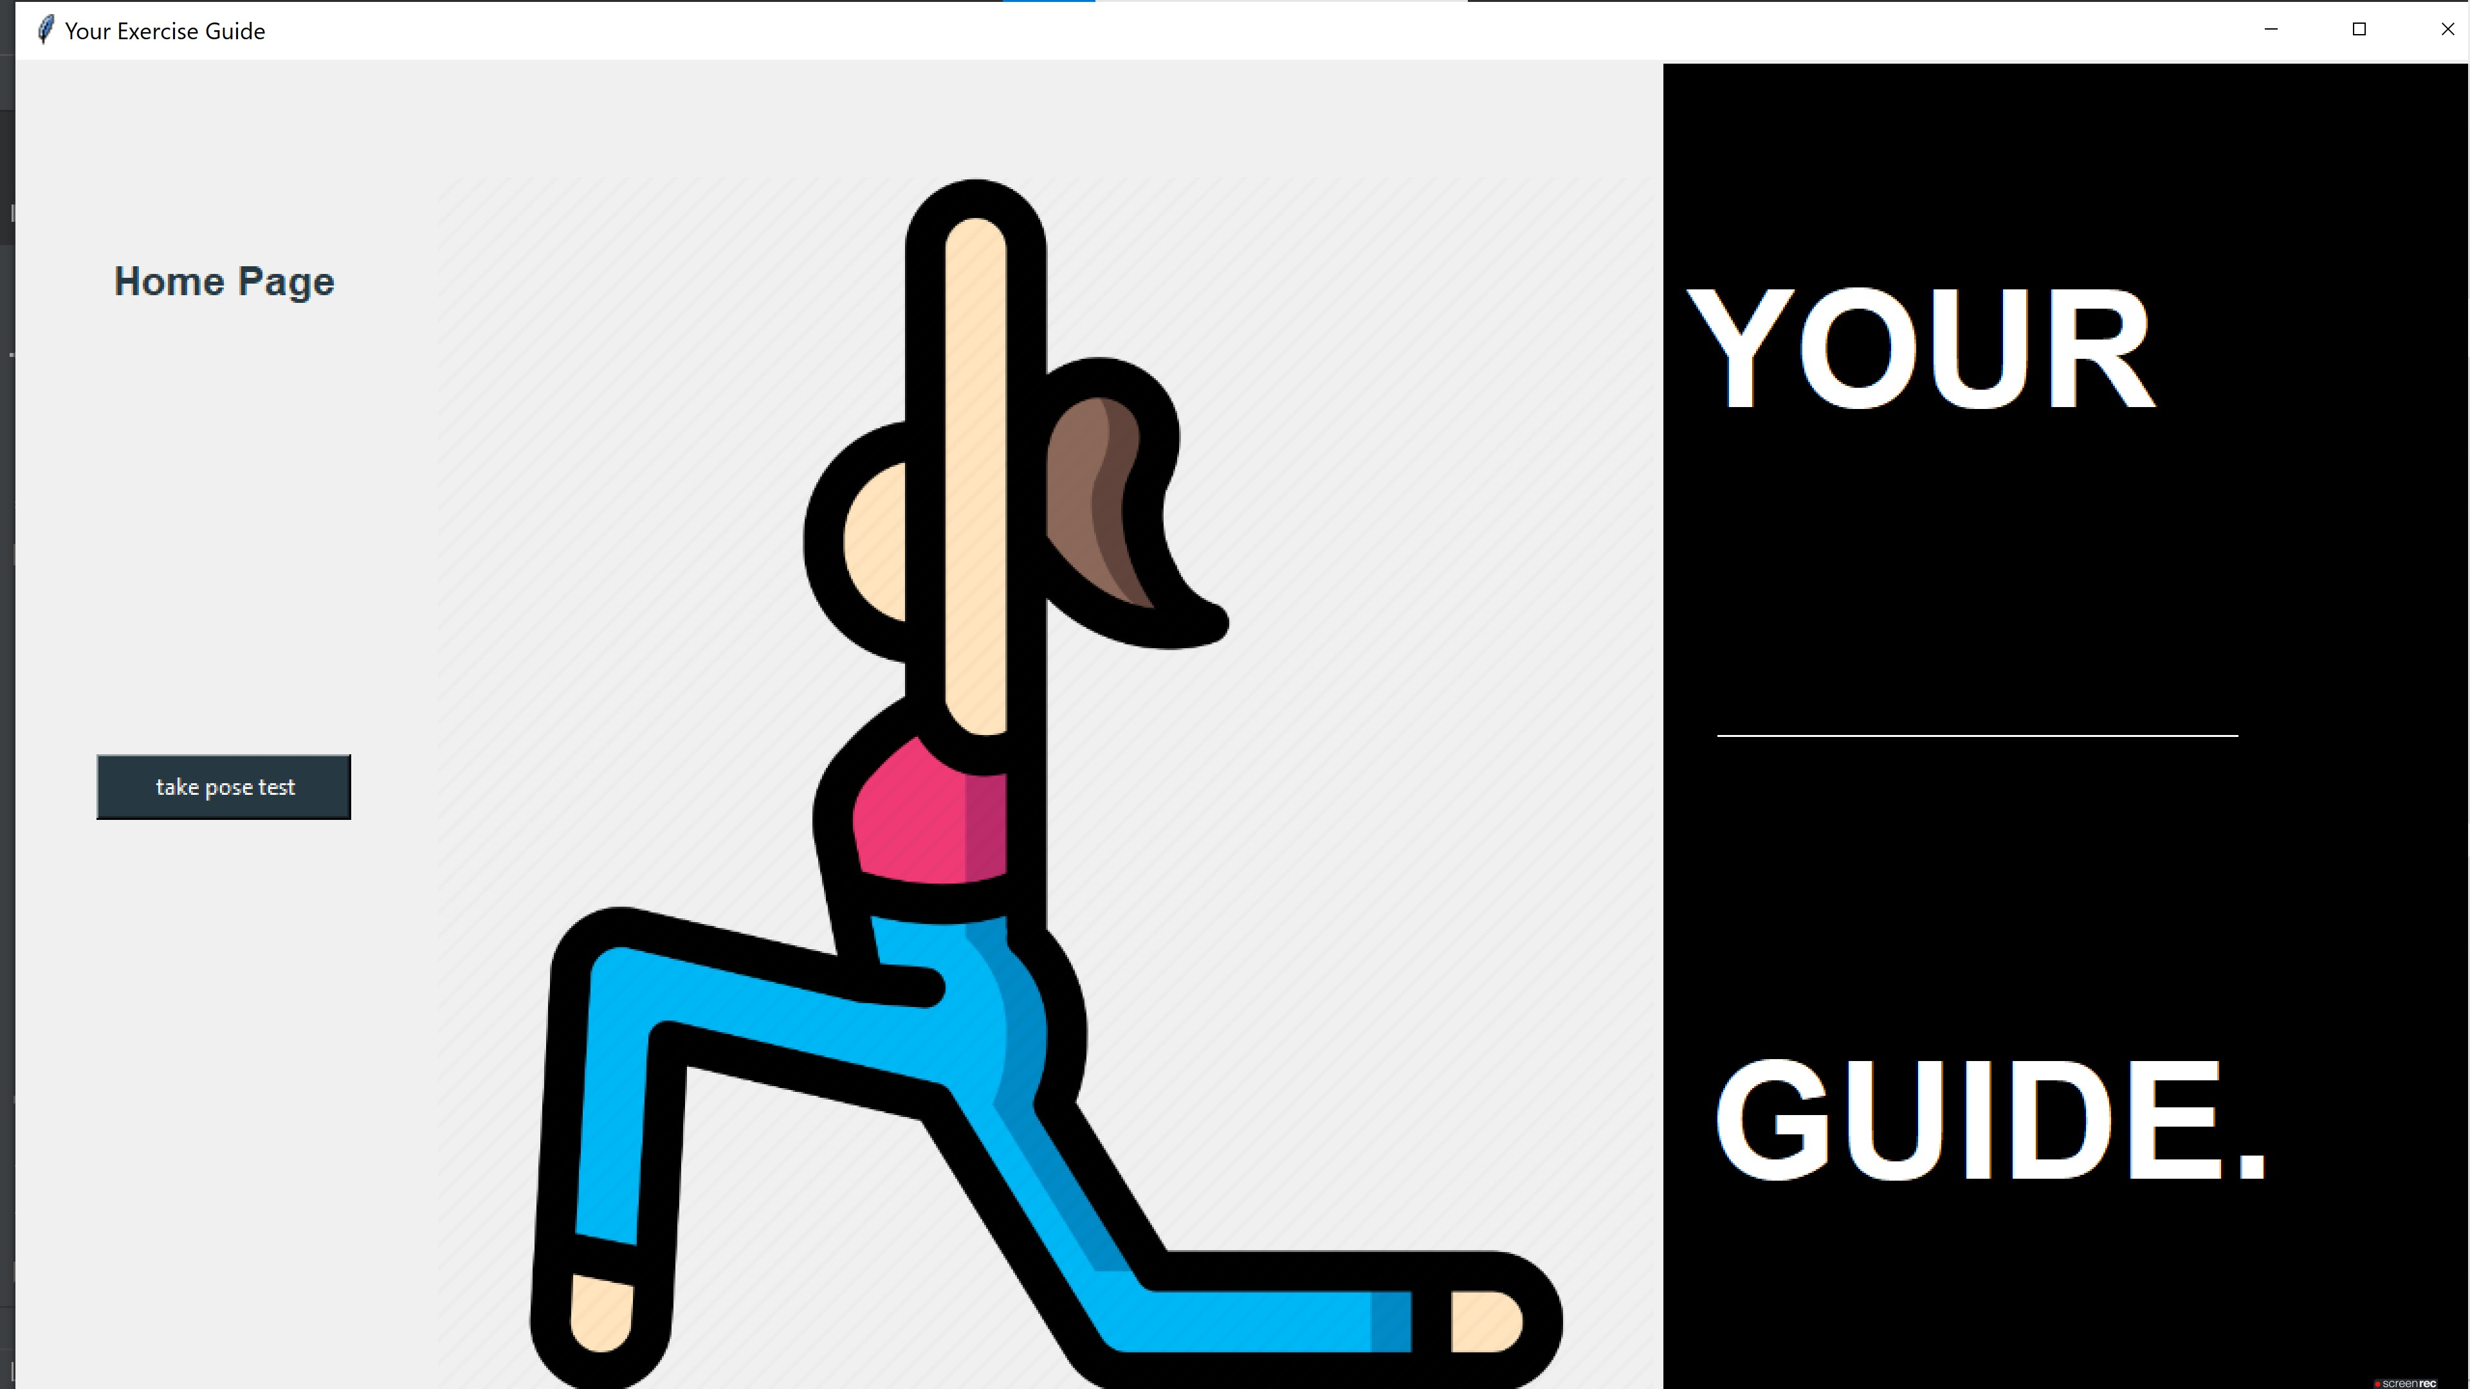
1. Project: Virtual Trainer
Contribution: Prototype – Pose Correction App - Google’s Mediapipe Pose detection model
GUI Implementation using Tkinter
Language: Python

Slide 2
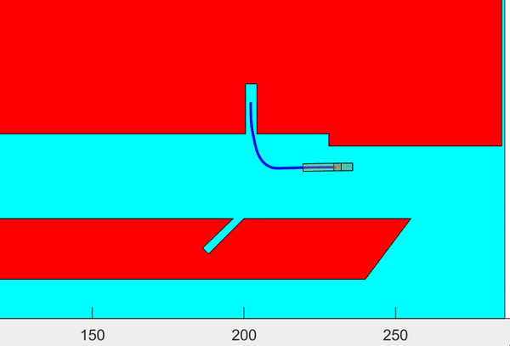
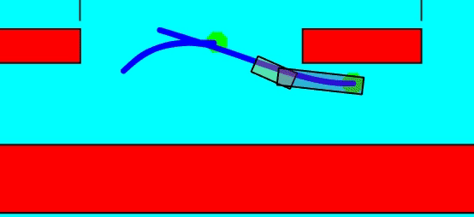
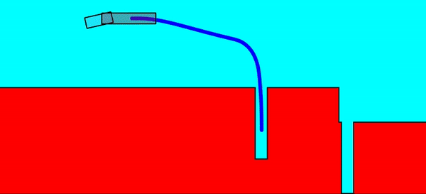
2. Project: Articulated Vehicle complex Maneuvering using CL-RRT
Contribution: - Considering Single Articulated Vehicle Forward and Inverse Kinematics, a Pure – Pursuit Steering controller and kinematic model combination has been introduced into a Closed – Loop Rapidly exploring Random Tree path planner
- Sub task of Driver assistance system
Language:
Matlab-Simulink-Stateflow
Python

Slide 3
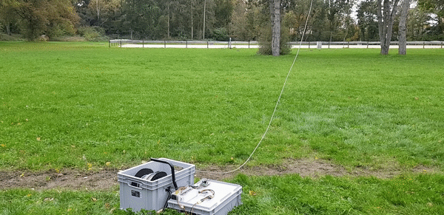
3. Project: Tethered Drone System
Contribution:
Prototyping
DroneKit – SITL preflight check with software in the loop simulation
Automatic tether winding mechanism with onboard load sensor feedback
Language: Python – C++

Slide 4
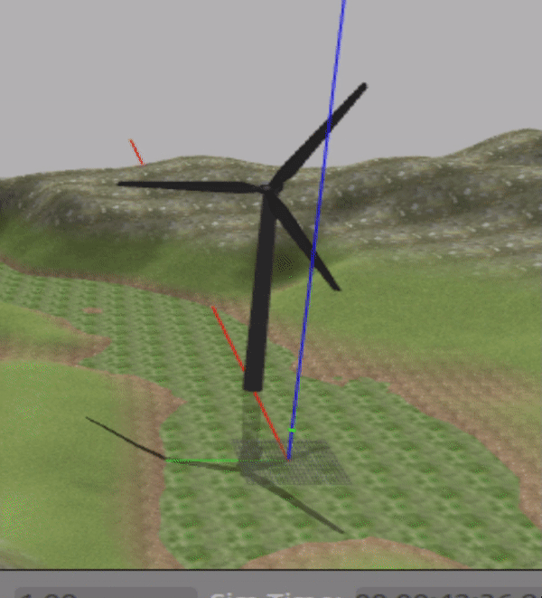
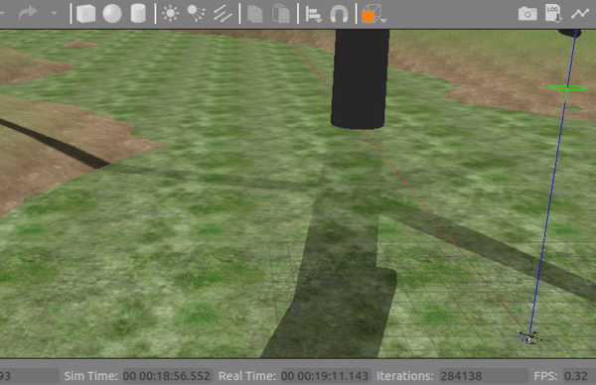
4. Project: Gazebo Simulation world and ROS
Contribution: Mission Simulation for Algorithm and Flight controller - Ref simulation world and UAV model in Gazebo
ROS; Dronekit; SITL; combination
Language: Python - ROS
Navigation
- simple waypoint navigation
Reference way point calculation around a chosen test object
Obstacle avoidance (2D Lidar)
Precise High quality GPS module procurement
Vision based navigation (RTAB-SLAM)

Slide 5
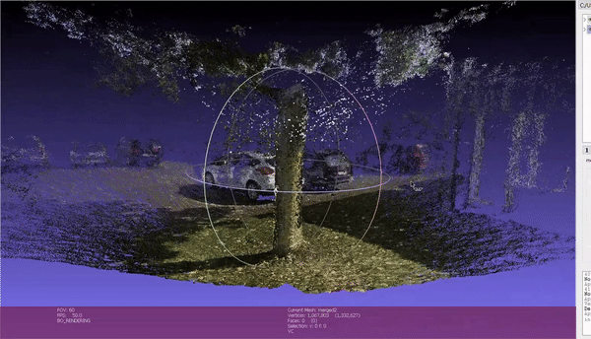
5. Project: Visual Navigation
Contribution: Visual Navigation - Point cloud generation based on OpenSFM
Simulation world - use simple RGB camera on the UAV
Navigation
Test RGBD SLAM
Computer vision based feedback for drone navigation
Language: Python

Slide 6
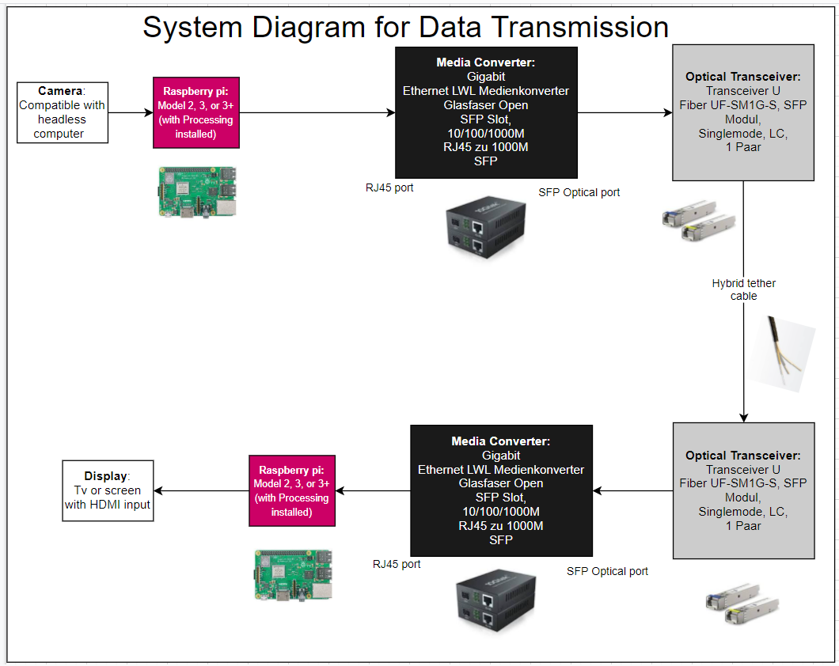
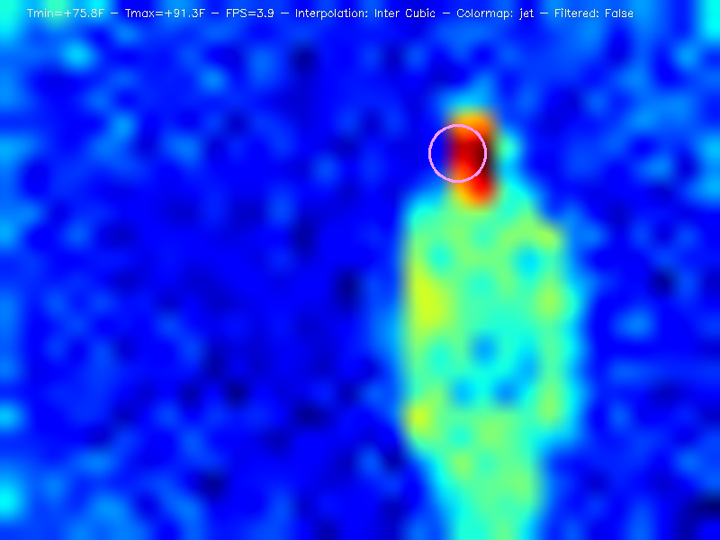
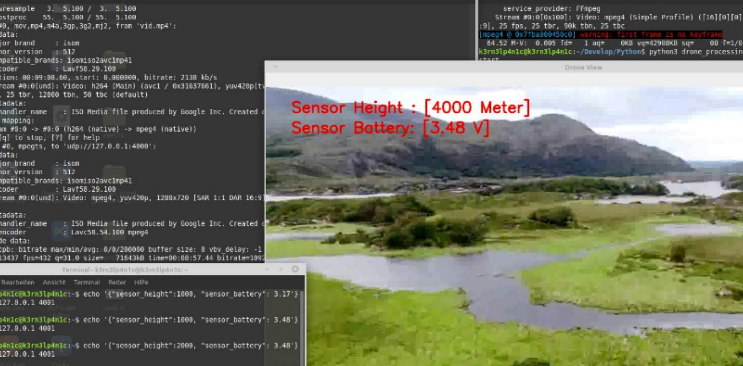
6. Project: Data transmission
Contribution: Data transfer over long distance - Client – server communication model
Data transmission from Altitude, thermal sensors and real time flight data from client node on drone to server node at the ground station
using Optic fiber cable and network configuration
Proof of concept - achieved
Language: Python

